Slide 1

CYBER CRIME SCENE DO NOT LOGIN– CYBER CRIME SCENE DO NOT LOGIN– CYBER CRIME SCENE DO N
CYBER CRIME SCENE DO NOT LOGIN– CYBER CRIME SCENE DO NOT LOGIN– CYBER CRIME SCENE DO N
CYBER CRIME SCENE DO NOT LOGIN– CYBER CRIME SCENE DO NOT LOGIN– CYBER CRIME SCENE DO N
CYBER CRIME SCENE DO NOT LOGIN– CYBER CRIME SCENE DO NOT LOGIN– CYBER CRIME SCENE DO N
CYBER CRIME SCENE DO NOT LOGIN– CYBER CRIME SCENE DO NOT LOGIN– CYBER CRIME SCENE DO N
CYBER CRIME SCENE DO NOT LOGIN– CYBER CRIME SCENE DO NOT LOGIN– CYBER CRIME SCENE DO N
CYBER CRIME SCENE DO NOT LOGIN– CYBER CRIME SCENE DO NOT LOGIN– CYBER CRIME SCENE DO N
Cyber Crime Investigation
By Viral Parmar

Slide 2



Who Am I
@viralparmarhack
Viral Parmar
ComExpo Cyber Security Foundation
Cyber Security Researcher
Mozilla Reps, Mozilla Foundation
Given 700+ session all over the world
Solved 500+case of cyber crime and aware more then
10 lakh people about privacy and security
Motto: Know hAckiNG, but no HaCKing.

Slide 3

What is Cyber Crime?
Creates high Impact: Impact is severe and may be for long term
Targeted Cyber crime
Computer as a tool
Stolen data, piracy , online hacking , bank fraud, website hacking
Mobile as a tool - Storage device for digital evidence, (sms)hing, threat, sexual harassment, free calls(VOIP), mobile theft cloning
Any electronic device

Slide 4

Types of Cyber Crime
Hacking
Cyber stalking / Harassments – threats, hate e-mails
Phishing, Vishing
Password cracking, recovery
Malware (virus, worms, Trojan horse, logic/time bomb)
DDoS Attacks
Scams – charity, lottery, shares
Click frauds - fake links
Social Engineering
Banking Frauds
Cyber Terrorism

Slide 5
Types of Cyber Crime
Hacking (Under Section 66 ITAA 2008)
Denial of Service (DoS) (DDoS) attack (Under Section 66 of ITAA 2008)
Spreading viruses and malware (Under Section 66 of ITAA,2008)
Website defacement (Under Section 66 of ITAA 2008)
Cyber terrorism (Under Section 66F of ITAA 2008)
Spoofing (Under Section 66A, 66D of ITAA 2008)
Skimming (Under Section 66C of ITAA 2008)
Pharming /click frauds/ fake links (Under Section 66C, 66D of ITAA 2008)
Spamming (Under Section 66A of ITAA 2008)
Social engineering
Phishing/vishing
Password cracking
Scam – charity , lottery, share

Slide 6
Types of Cyber Crime
Banking/Financial fraud
(Several sections under IPC, ITAA 2008 and other applicable laws)
Data modification
(Under Section 66 of ITAA 2008 and sections 403,406,408,409 of IPC as applicable)
Identity theft and its misuse
(Under Section 66C, 66D of ITAA 2008)
Cyber bullying/Stalking
(Under Section 66A of ITAA 2008 and sections 500,504,506,507,508,509 of IPC as applicable)
Data theft
(Under Section 66 of ITAA 2008 and section 379 IPC)
Pornography
(Under Section66E, 67, 67A and 67 B of ITAA 2008 and section 292 IPC)
Theft of trade secrets and intellectual property
(Under Section 66 of ITAA 2008, IPR laws and other applicable laws
Espionage on protected systems
(Under Sections 66, 70 of ITAA 2008 and other applicable laws)

Slide 7
Techniques of Cyber Crime
Buffer overflow
Cracking
Data Didling
Malware
Ransomware
Phishing
Salami Attack
Sniffer
Social Engineering
Spoofing
Steganography
Identity Theft
DoS/Ddos
APT
Brute force / Password Cracking
Wifi Hacking
Mobile Hacking
Exploit
Spam

Slide 8
Pre-Investigation Assessment
Doing the Basics Right
Is it a crime as per ITAA 2008?
Preliminary Review of the Scene of Offence
Pre-Investigation Technical Assessment
Issuance of preservation notice
Containment of the incident / Offence

Slide 9
Doing the Basics Right
Very important for every Investigating Officer (IO) to do a pre-investigation assessment for each cyber crime / incident that is reported
Potential issues to look for:
Before the complainant approaches the police officer or any agency for addressing their problems, they may have made attempts to set the things right all by themselves or with the help of their friends or some other persons
These very acts may result in destruction of crucial digital evidence(s)
Sometimes the criminal act may be a crime in progress, which can potentially cause further damage
The complainants in their anxiety or due to ignorance may not disclose the full facts at the outset
The IO should collect necessary information from complainant(s) / victims as part of the pre-investigation assessment to understand
The full scope of the incident
The possible outcomes
The action/next steps in the investigation that is needed
Digital evidence is very critical and volatile; hence it is necessary to protect and collect the right evidence for the pre-investigation assessment

Slide 10
Is it a crime as per IT Act
The ITAA2008 contains explicit penal provisions for certain offences (43, 66 A to F ).
For an act to be investigated under Section 66 of the ITAA2008 as a Cyber Crime, it needs to satisfy two conditions
It has to be an act as defined under Section 43 of the ITAA2008
It should have been done by a person with dishonest or fraudulent intentions
Explanation of the words, dishonestly and fraudulently shall have the same meaning as in Section 24 and 25 of the Indian Penal Code

Slide 11
Once the information reveals the commission of cognizable offence under the ITAA2008 and other acts, the IO should
Elicit the information regarding the act under report in detail; ensure that the details of the offences are captured in the complaint, in full
Indicate the nature/modus operandi of the cyber crime in detail (include the e-mail address, systems, time zones etc.)
Indicate all the details that can be identified from the complaint
IP address in case of e-mail and Internet
Profile name or user name in case of social networking abuse
Bank details/Internet banking, branch, etc., in case of online fraud
Credit card details and nature of purchase, etc., in case of card fraud
Include the time and date in the exact format the complainant mentioned or noted in any of the documentation attached with the complaint (such as e-mails)
Time zone conversion will have to be taken care during the course of investigation

Slide 12
Preliminary Review of the Scene of Offence
Typical scene of offence
Home of individuals with one or more computers
Cyber Café/Public places
Companies / organizations, with one or more computers, or vast and complicated network of systems
IO should carefully survey the scene, observe and assess the situation and decide on the steps for proceeding further
The pre-investigation assessment will help the IO to understand the local situation, circumstances and technical details of the systems / network at the scene of the crime before proceeding to seize / preservation of evidences
Examples of devices that contain evidence: copiers, fax machines, routers, hubs etc., apart from the standard storage / computer devices
Such observations/preliminary review notes are included in the questionnaire that needs to be sent to FSL for expert opinion
FSL: Forensic Science Laboratory
IO should videograph / photograph and draw the network architecture sketch in ‘as is where is’ condition of the crime scene and document it in the proceedings

Slide 13
Two steps:
Evaluating the Scene of Offence
Preliminary Interviews at the Scene of Offence
Evaluating the Scene of Offence
After identifying the scene of offence, IO should secure it and, take note of
every individual physically present
their role at the time of securing the scene
IO should identify all the potential evidences
include conventional physical evidences like the manuals, user guides
passwords on slips, bank account numbers etc.
Note the position of the various equipment and items at the scene of offence
Example: a mouse on the left hand side of the desktop possibly indicates the person operating the computer is a left-handed user

Slide 14
Potentially perishable evidence is to be identified and all the precautions are put in place for its preservation
At the time of review, disturbing or altering the condition of electronic evidences should be avoided.
If the systems are OFF, they should not be turned ON for the inspection. If ON, leave them ON.
If systems are ON at the scene of offence, IO should take appropriate steps to photograph it, plan for the seizure of the evidences at the earliest and document it.
IO should make note of the attached network cables and power lines to the systems
make a note of all the network connections, modems, telephone lines
mark them both at (i) the equipment connection end (ii) from the source in the walls
Preliminary Interviews at the Scene of Offence
Some interview questions are:
What steps were taken to contain the issue? (along with list of all suspected names, address, etc.)
Were there any logs (system access, etc.) present that cover the issue? Are there any suspicious entries present in them?
Did anyone use the system after the issue occurred?
Did you observe any similar instance before?
Were there any alarms that were set off by the firewall/IDS/network security devices?

Slide 15
Please give a detailed documentation on the set of commands or processes run on the affected system or on the network after the issue occurred. (Request a letter of confirmation from complaint)
Do they have similar systems in any of the branch/other offices?
Whether log register of the Internet users/other users is maintained?
Are there any questions about the issue that have not been answered?
What are the further plans for analysis of the issue?
IO’s actions:
Identify the complainant / owner(s) of the various devices and obtain the access details, usernames, service providers’ details
Ensure that these persons are available along with the search and seizure team
Gather information as provided in the questionnaire on all the security systems
Encryption policies
off-site data storage
data center and disaster recovery policies of the organization
back-up plans
Identify the list of the people who can identify the network
A schematic diagram of the network will be useful to be prepared during the interviews.

Slide 16
Pre-Investigation Technical Assessment
Scene of Offence: Home
Identify the type of connection (Wi-Fi/Ethernet)
How many computer systems are used for Internet connection
Location and details of persons with access to systems
Details about the removable storage media (including external hard disk) used/owned by the user
Details about the network topology and architecture (client-server), if any
Details about other computer peripherals (printer/scanner/modem, etc.)

Slide 17
Issuance of Preservation Notice
The IO should come out with issues to be complied immediately by issuing specific do’s and don’ts to the complainant/company/agency
e.g. stopping the access, taking backups, preserving log information
Issue: continuing access to the e-mail by the accused can enable him to delete the mails which are incriminating in nature
A preservation notice needs to be sent to all affected parties to make sure that they do not delete any data

Slide 18
Containment of the incident / Offence
Incident containment refers to the determination of the nature and scope of the incident and then minimizing the damage, if any
Containment steps:
Having more rules on the firewalls to block access
Taking the affected machines off the network
Disabling user access controls
Reasons:
It is embarrassing if any additional incidents occurs
It is possible that the issue that is reported to the agencies may be one of incident out of a series of incidents which are part of an ongoing crime
Some criminal links in the chain of the original incident may still be active
In case of financial frauds, the IO should immediately contact the concerned branches of the banks to freeze the beneficiary/suspect/accused person’s bank accounts in case of fraudulent money transfers.
The IO should request the Service Providers to block/remove and at the same time preserve the access details of the fake/defamatory profiles in social networking/community Web sites.
The IO should also notify the Service Providers to preserve the access details of the defamatory/obscene contents.

Slide 19
If restoration is immediately required:
If the targeted system is to be restored by the affected party immediately for commercial reasons or in public interest, the IO should
Obtain the services of technical personnel from the Cyber Forensics divisions
Obtain the image copy of the affected system and permit restoration of the system after that.
These actions need to be documented with enough justification and should be used under rarest of the rare circumstances.
Normally, the restoration is done after the seizure of the evidences and not at the immediate stage of the reporting of the crime.

Slide 20
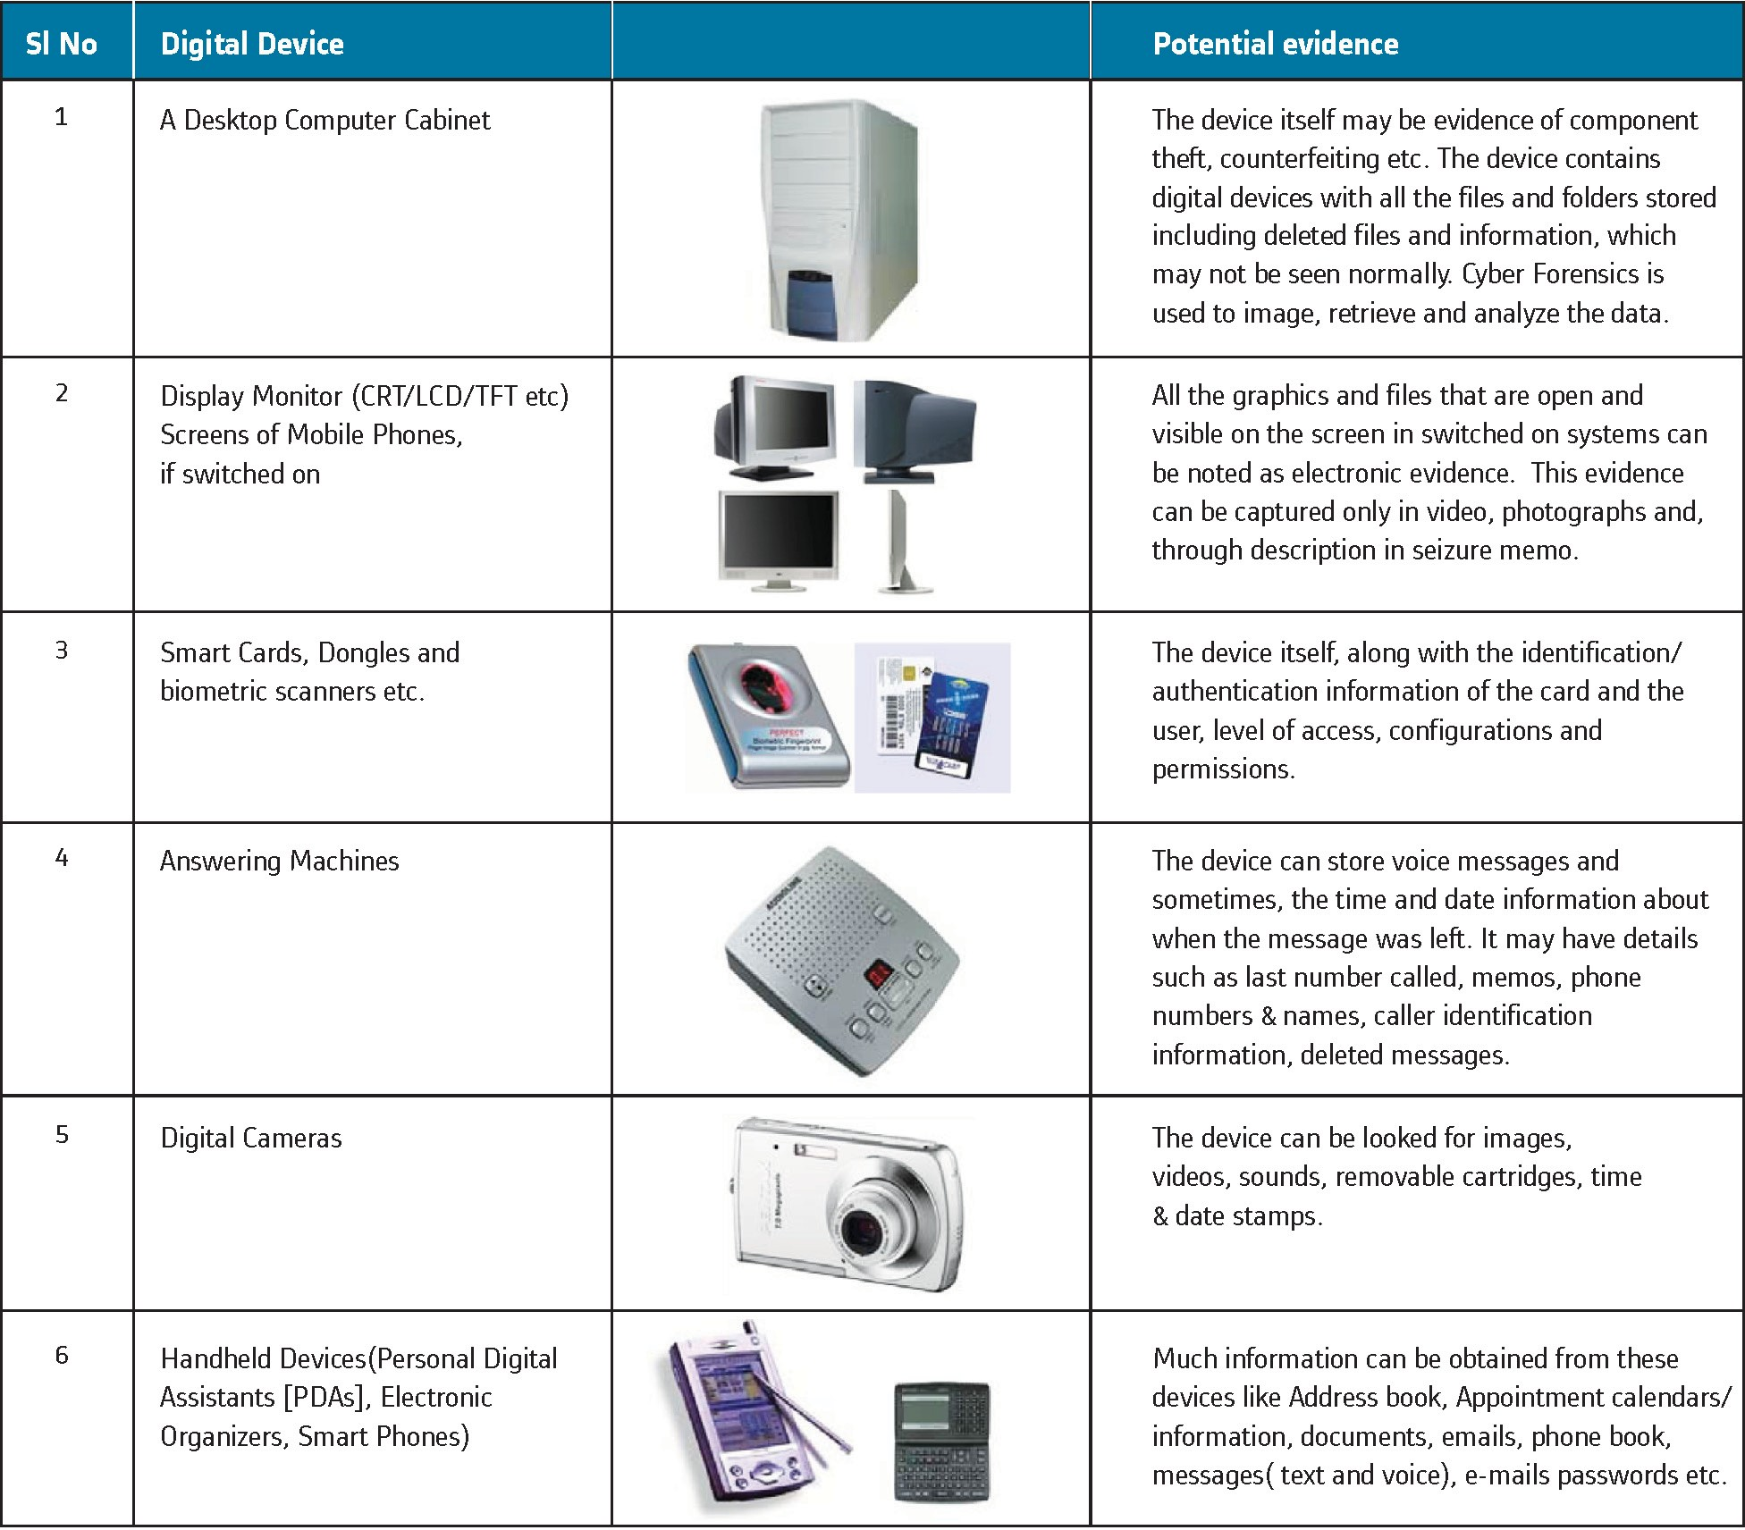
Digital Evidence

Slide 21
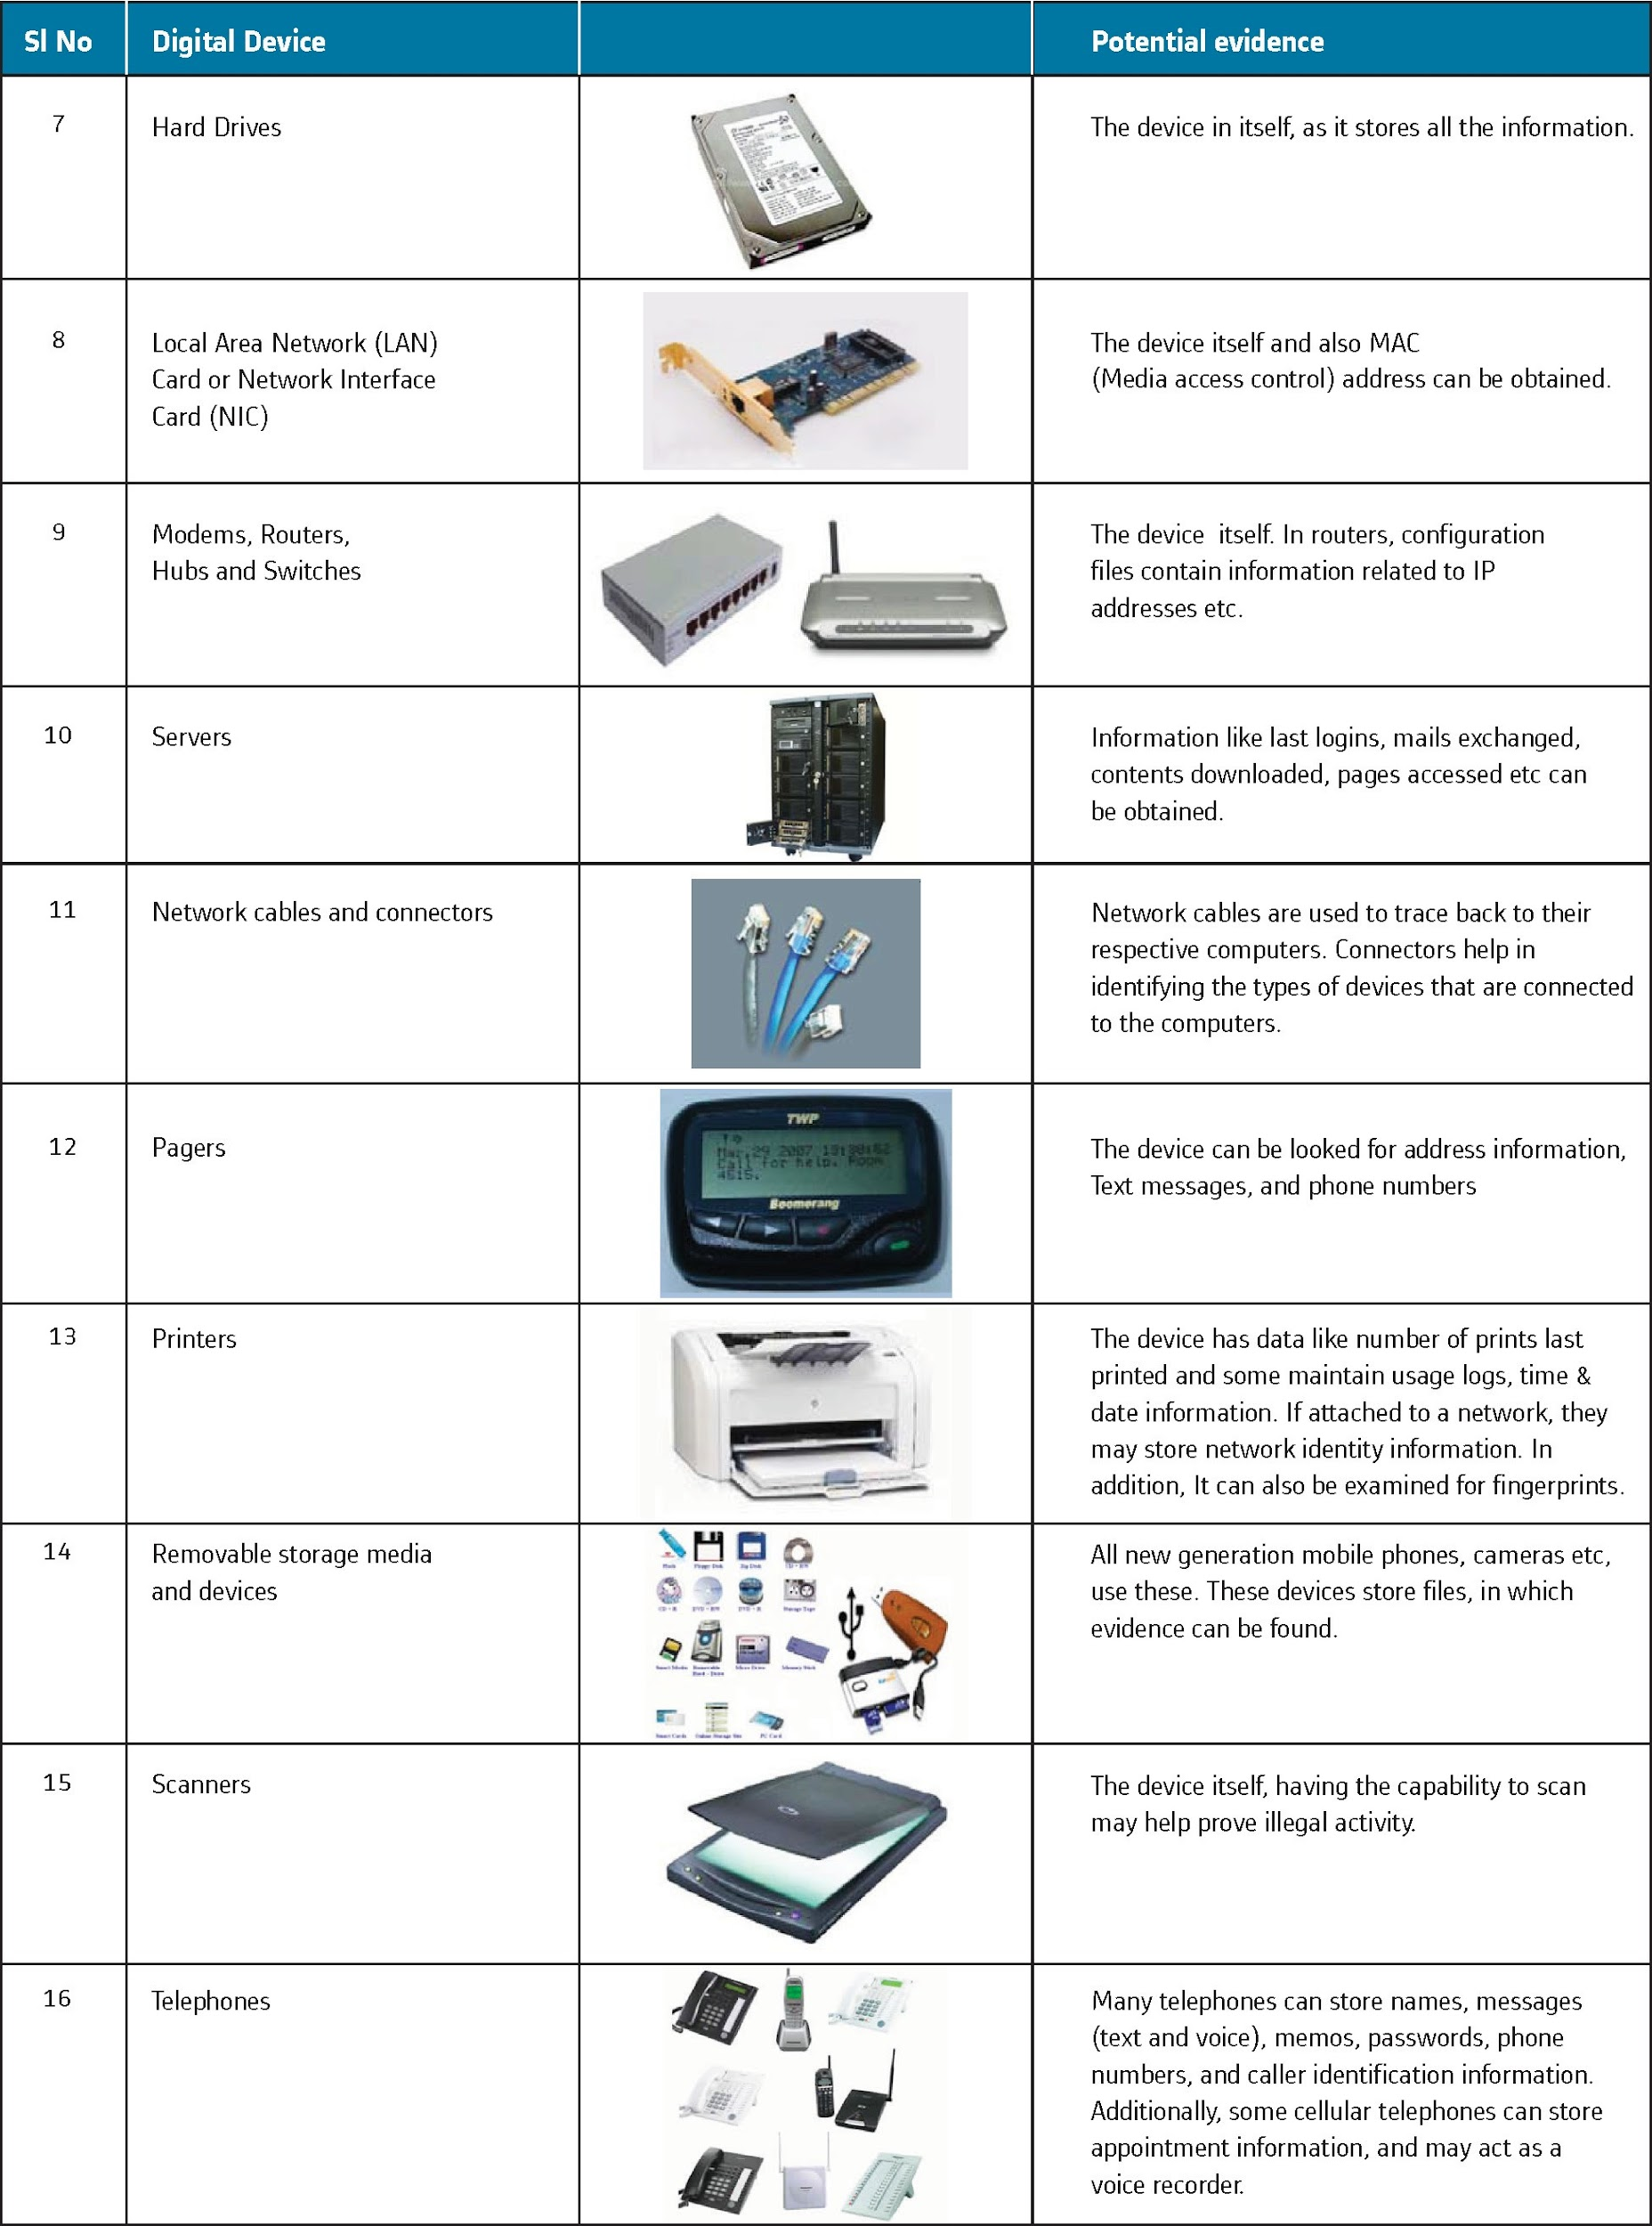

Slide 23
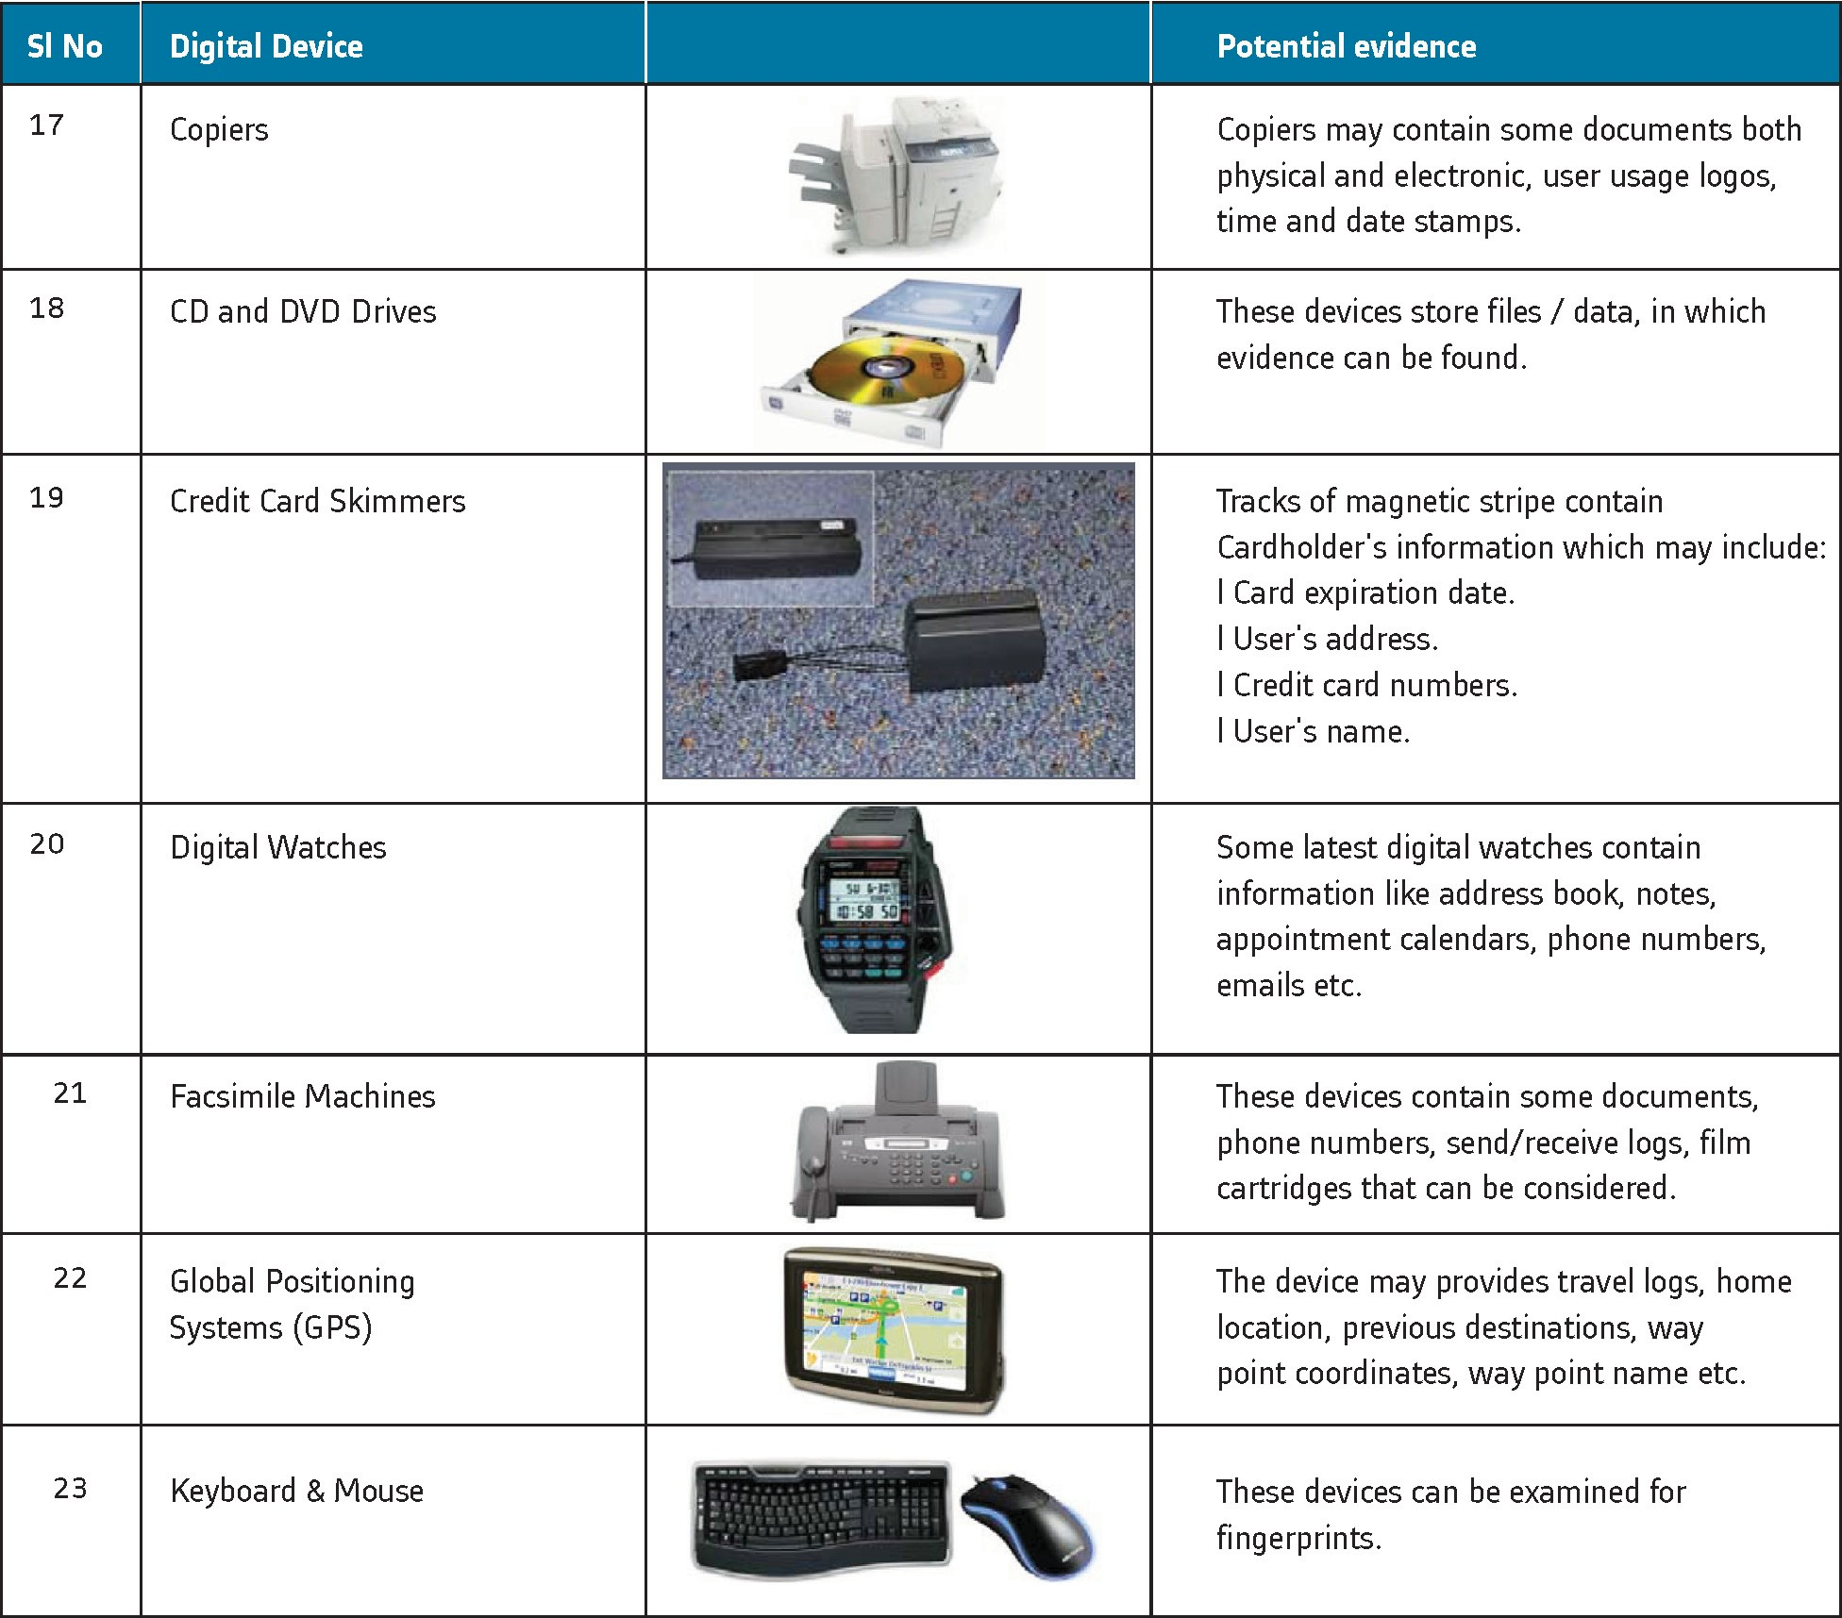

Slide 24
Importance of SOPs in the Investigation
SOP: Standard Operating Procedures
Guide us to develop every process in the investigation right
Includes securing the scene and identifying media to be collected, etc.,
Guidance till charge-sheet is filed and evidence is adduced in the court of law
Investigations in an automated environment requires standard methods and procedures for the following main reasons
Evidence has to be gathered in a way that will be accepted by a court of law
Easier if standard procedures are formulated and followed
Will facilitate the exchange of evidences in cases having interdepartmental and international ramifications
Care must be taken to avoid anything which might corrupt the data or cause any other form of damage
use of standard methods and procedures minimizes this risk
thorough understanding of technology and its documentation is required to explain the causes/ effects later on in a court of law in case of data damage during collection.
Maintaining chain of custody is important
poorly written policies, lack of an established incident response plan, incident response training are damaging
primary reasons for improper evidence collection

Slide 25
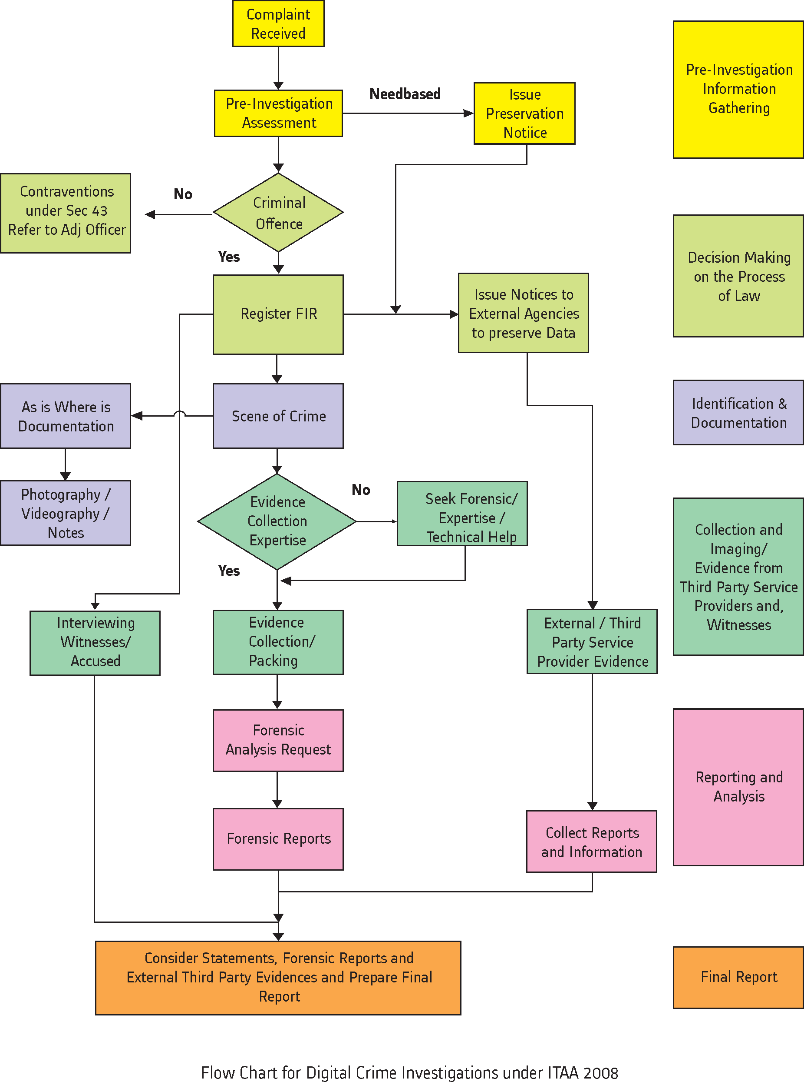

Slide 26
Crime Scene Investigation: Search and Seizure
Steps in Crime Scene Investigation
Panchanama (Seizure Memo) and Seizure Proceedings
The sequences of steps for digital crime scene investigations are
Identifying and securing the crime scene
Documentation of the scene of offence
Collection of evidence
Procedure for gathering evidences from Switched-off Systems
Procedure for gathering evidence from live systems
Forensic duplication
Conducting interviews
Labelling and documenting of the evidence
Packaging and transportation of the evidences

Slide 27
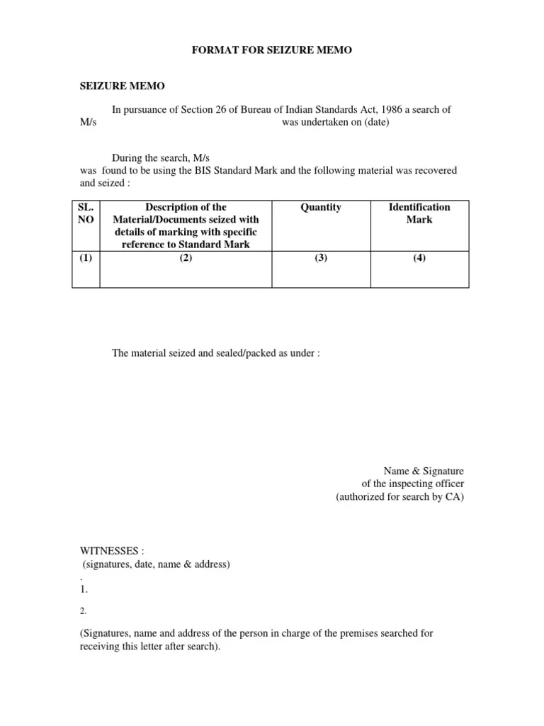
Panchanama
Also known as ‘seizure memo’
Form filled wherever some material is seized by a forensic investigator
The Investigating Officer has to take additional care while conducting panchanama and seizure of digital evidences keeping in mind the nature of digital evidences

Slide 28
Conducting Interviews
General Investigative Questions
When did the incident first come to his (complainant) notice?
How it was established that action in question has been performed by any outsider or some user has performed in excess of his privileges provided?
What are the foreseen damages?
Who could be the potential intruder (Prime Suspect)?
What is the main reason of such doubt?
What could be the major impact on the business?
What are the major Systems which are required to run the critical functions of the business?
What actions have been taken to identify, collect, preserve, or analyze the data and the devices involved?
Have the evidences been collected by a trained person?

Slide 29
Seizure Proceedings
Guidelines:
One of the technical people from the responder side along with two independent witnesses is part of the search and seizure proceedings
Identify the equipment correctly
Guide the IO and witnesses
Please refer to the notes made during the pre-investigation assessment
Cross verifying and correctly documenting the technical information
Equipment, networks and other communication equipment at the scene of crime
Time Zone/SystemTime has to be noted carefully in the panchanama, from the systems that are in ‘switched on’ condition
Devices should not be switched on
Serial number is to be allotted for each device
Should be duly noted
Panchanama, Chain of Custody and Digital Evidence Collection forms.
Each device is to be photographed before starting of the investigation process at their original place
Cubicle number or name room soundings etc.
Photograph the Hard Disk Drive or any other internal part along with the system, once removed

Slide 30
Paste the serial number with Crime number/section of law
Note all the information about the system and data in the panchanama
Includes searching and seizing
Brief the witnesses regarding the tools used to perform search and seizure of the digital evidence
Panchas (witnesses) must have some knowledge and ability to identify various digital devices
Document the Chain of Custody and Digital Evidence Collection forms
Make sure all the details mentioned in the forms are completely filled

Slide 31
Chain of custody
Chain of custody refers to the documentation that shows the people who have been entrusted with the evidence
People who have seized the equipment
People in charge of transferring the evidence from the crime scene to the forensic labs
People in charge of analysing the evidence etc.

Slide 32
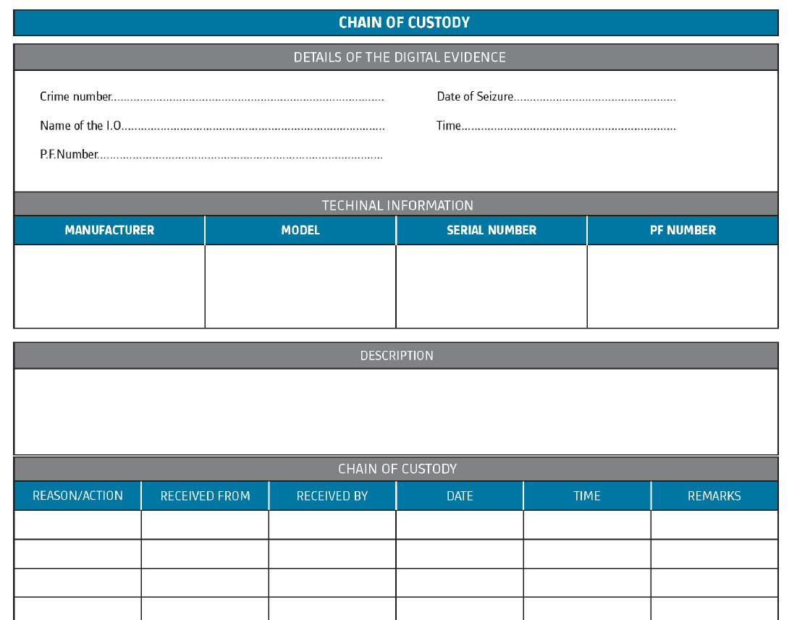

Slide 33
Guidelines for collecting evidence
Physically inspect the storage medium — take photographs and systematically record observations.
Guard against hazards like theft and mechanical failure.
Use good physical security and data encryption.
House multiple copies in different locations.
Protect digital magnetic media from external electric and magnetic fields. Ensure protection of digital media particularly optical media from scratches.
Account for all people with physical or electronic access to the data.
Keep the number of people involved in collecting and handling the devices and data to a minimum
Always accompany evidence with their chain-of-custody forms
Give the evidence positive identification at all times that is legible and written with permanent ink.

Slide 34
Establishing the integrity of the seized evidence through forensically proven procedure by a technically trained investigating officer
or with the help of a technical expert
will enhance the quality of the evidence when the case is taken forward for prosecution.
The integrity of the evidence available on a digital media can be established by using a process called as “Hashing”.
Establish a baseline of contents for authentication and proof of integrity by calculating hash value for the contents.
An identical hash value of the original evidence seized under panchanama and, the forensically imaged copy,
Helps the IO to prove the integrity of the evidence.
Hashing program
produces a fixed length large value (ranging from 80 – 240 bits)
Represents the digital data on the seized media
Any changes made to the original evidence will result in the change of the hash value
Hashing is applying a mathematical algorithm
A file/disk/storage media
Produce a value that is unique like fingerprint to that file/disk/dataset
Any changes that will be made in the file/dataset will in turn change/alter the hash value
Hash value is usually alphanumeric

Slide 35
Forensic Collection of Digital Media
Identifying/Seizing of the devices needs to be forensically imaged for analysis
Pre-investigation assessment must be complete and accurate before commencing the Crime Scene Investigation
Be ready to identify all the relevant parties and equipment at the scene
If the person at the scene of crime is not able to tell if the device is relevant for investigation, seize it
Documentation tools
Pen and paper for notes
Stick-on labels etc.
Disassembly and removal tools in a variety of nonmagnetic sizes and types
Screwdrivers
Wire cutters etc.
Packaging and transporting supplies
Bubble wraps
Sturdy boxes etc.
Other miscellaneous items
Gloves
Magnifying glass
Small flashlight

Slide 36
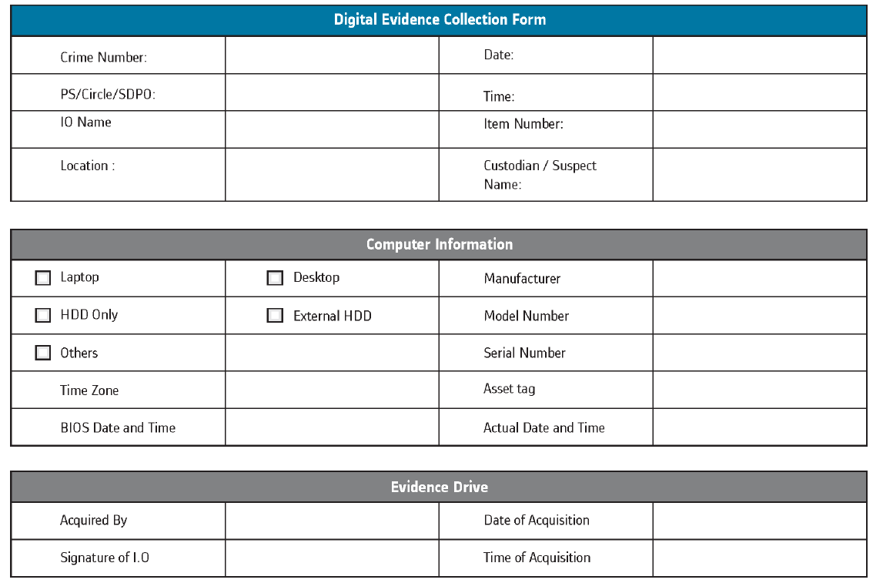

Slide 37
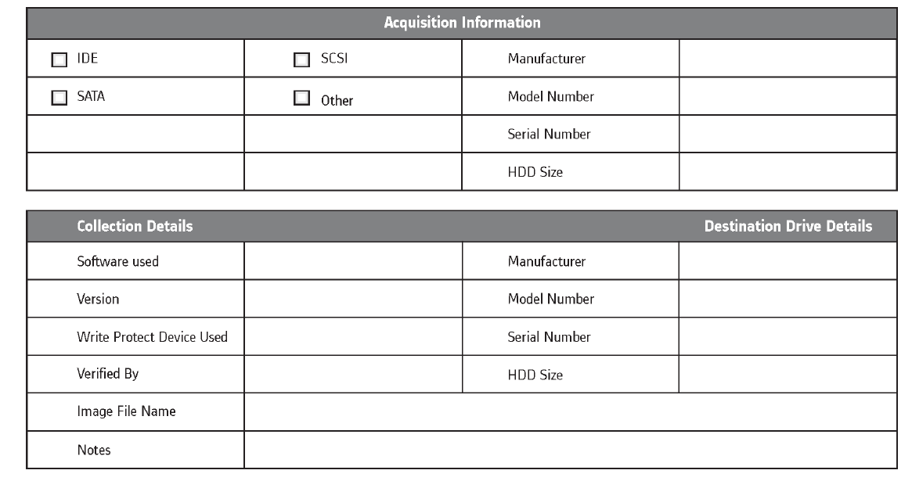

Slide 38
Packaging and labelling of the evidence
Package and labeling refers to collection of the evidence
Numbering them in a way that it would be easy to go back and retrieve the data at a later date/time
Every piece of evidence needs to get a tag number
Contains all the visible details on the evidence
This information goes into evidence Database
The IO has to choose packaging that is of proper size and material, to fit into the evidence
Various types of evidence need special packaging,
Need to come to the scene prepared with a variety of evidence envelopes, bags, and containers
The packaging should also be clean, and preferably new, to avoid contamination
Each piece of evidence should be packaged separately
Should be properly labeled, sealed, and documented
Use anti-static bags to transport evidence
These will protect and prevent any localized static electricity charge from being deposited onto the devices as the bags are handled

Slide 39
Transportation of the evidences
The dispatch and transportation of evidences is another crucial aspect that has to be kept in mind by the IOs
Poor dispatching and transportation practices can physically damage the evidences collected and thereby rendering them useless
Sometimes, the poor handling may result in alteration of the contents of the digital evidences due to shock and external electro-magnetic interferences
Two things to ensure while sending the evidences to the Forensic Science Laboratories
The suspected computer storage media is carried by a special messenger and not by Registered / Insured post
A fresh hard disk of approximately same capacity should also be submitted for forensic imaging along with the suspected storage media.

Slide 40
Legal procedure post-seizure of evidence
Once the digital evidence is seized during the course of investigation, it has to be brought to the notice of the jurisdictional court
Obtain orders of the competent court to retain the seized properties in the custody of the investigating officer for the purpose of investigations
Obtain necessary orders from the competent court to image the data
Send the digital evidence for forensic analysis and expert opinion
In cases where the accused persons or the owners of the property seized approaches the court for release of the impounded properties
IO should carefully prepare objections for such applications
Ensure that no original evidences are returned which have a bearing on the prosecution of the case
Unless the court specifically orders, releasing seized properties means releasing a forensically imaged copy

Slide 41
Four principles for dealing with digital evidence
No actions performed by investigators should change data
Individuals accessing original data must be competent to do so
An audit trail must be created and preserved documenting each investigative step
The person in charge of the investigation has overall responsibility for ensuring the laws and guidelines of the government

Slide 42
Expert Opinion from the Forensic Examiner
The forwarding letter to the FSL for scientific analysis and opinion should mention information like:
Brief history of the case
The details of the exhibits seized and their place of seizure
The model, make and description of the hard disk or any storage media
The date and time of the visit to the scene of crime
The condition of the computer system (on or off) at the scene of crime
Is the photograph of the scene of crime taken?
Is it a stand-alone computer or a network?
Does the computer have any Internet connection or any means to communicate with external computers?
Were the BIOS date and time stamps taken, or not? If taken the date and time should be mentioned

Slide 43
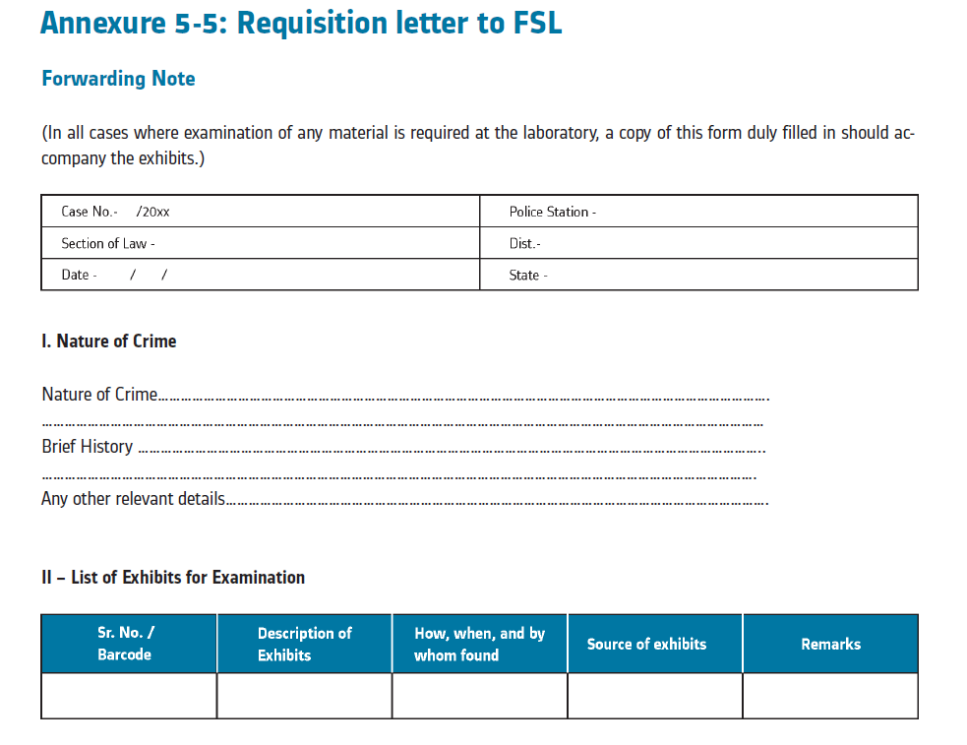

Slide 44
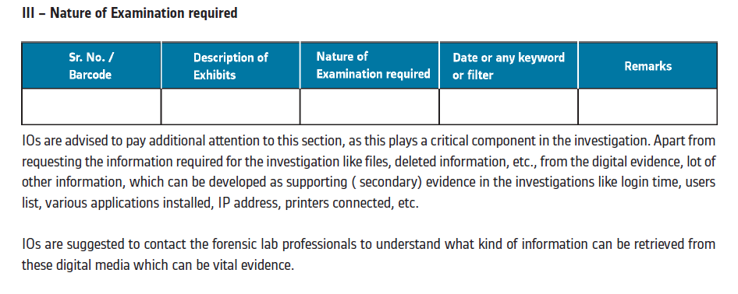
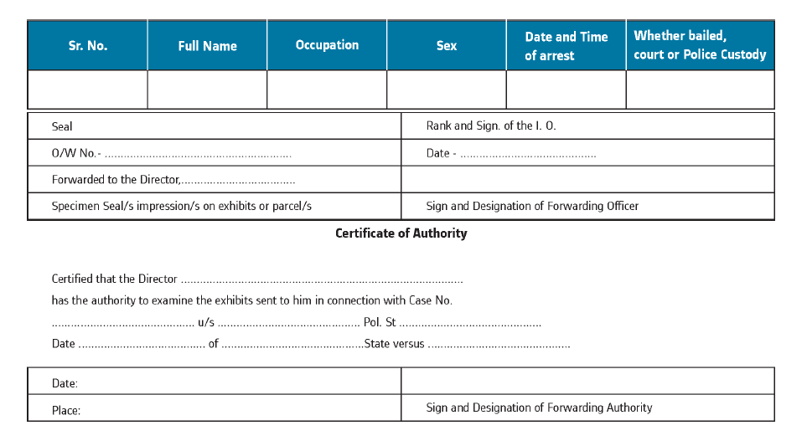

Slide 46
Laws / Guidelines Relating To International Investigations
Cyber Space and computers do not recognize national boundaries
Law is bound by national boundaries
Many a times the victim may be residing in one national boundary, the offender may be from another national boundary
Investigators during the course of investigations need to resort to conduct investigations outside their national boundaries and as per the criminal law of the foreign country
It is essential that, each Investigator handling cyber crimes possess the requisite knowledge of International investigations as prescribed under law and mandated by the Government.

Slide 47
Legal procedure to gather information from outside India
MLAT (Mutual Legal Assistance Treaty) and Letter Rogatory
Guidelines have been issued by the Ministry of Home Affairs, Government of India
The Code of Criminal Procedure (Cr.P.C) under Sec.166–A and 166– B provides for the process for making a request to any foreign country to help and assist in an investigation
Provisions of Law: 166-A Cr.P.C. Letter of request to competent authority for investigation in a country or place outside India

Slide 48
If an application is made by the investigating officer or any officer superior in rank to the investigating officer that evidence may be available in a country or place outside India
Any Criminal Court may issue a letter of request to a Court or
An authority in that country or place competent to deal with such request
Identify any person supposed to be acquainted with the facts and circumstances of the case
Record his statement made in the course of such examination
Require such person to produce any document or thing which may be in his possession pertaining to the case
Forward all the evidence collected or the authenticated copies to the Court issuing such letter
The letter of request shall be transmitted in such manner as the Central Government may specify in this behalf
Every statement recorded, or document or thing received shall be deemed to be the evidence collected during the course of investigation

Slide 49
Meaning of Letters Rogatory
A formal communication in writing sent by the Court in which action is pending to a foreign court or Judge
Requesting the testimony of a witness,
Witness residing within the jurisdiction of that foreign court,
Witness may be formally taken thereon under its direction
Transmitting to the issuing court making such request for use in a pending legal contest or action
Request entirely depends upon the committee of court towards each other and usages of the court of another nation

Slide 50
Letter of request from a country or place outside India to a Court or an authority for investigation in India
Upon receipt of a letter of request from a Court or an authority in a country or place outside India, the Central Government may, if it thinks fit
Forward the same to the Chief Metropolitan Magistrate or Chief Judicial Magistrate
Shall summon the person before him
Record his statement or cause the document or thing to be produced
Send the letter to any police officer for investigation, who shall investigate into the offence as if the offence had been committed within India
All the evidence taken or collected or authenticated copies shall be forwarded by the Magistrate or police officer to the Central Government for transmission to the Court or the authority issuing the letter of request

Slide 51
Procedure for Sending Letter Rogatory
In order to conduct formal investigation and to collect evidence and gather material objects/documents, 3 scenarios are considered:
Section 166–A of the Criminal Procedure Code, 1973 lays down the procedure of sending ‘Letter of Request’ (Letter Rogatory) through a competent Court
Letter is forwarded within the ambit of Mutual Legal Assistance Treaty (MLAT) in criminal matters, Memorandum of Understanding (MoU) Arrangement, etc.,
Treaties that exist between India and the requested country or on basis of reciprocity in cases where no such treaty or MoU exists
No request for issue of a Letter Rogatory (Letter of Request) shall be brought before any Court by an Investigating Agency without the prior concurrence of the Central Authority

Slide 52
The request must incorporate the following details:
The documents, Photographs, and objects, if enclosed with the Letter Rogatory, should be clearly marked and referred to in the body to enable the requested Authority to know clearly what is required to be done with them
All the photocopied papers and documents enclosed must be legible and translated into the required language
The Letter Rogatory should be neatly bound and page numbered
The authenticated translated copies duly signed by a translator should be enclosed along with the original Letter Rogatory, if required to be submitted in a language as prescribed in the MLAT, MoU, Arrangement, or otherwise
At least five copies of the Letter Rogatory should be prepared, including the original.
Three copies along with the translated version, if any, are to be sent to MHA (Ministry of Home Affairs) along with a copy to the International Police Cooperation Cell of CBI.

Slide 53
Normally:
The Investigating officer should obtain the NO OBJECTION CERTIFICATE from the Director of Prosecution /Department of Public Prosecution
The NOC will be issued by Dept. of Prosecution after looking into the Dual Criminality Principle
The Letter of Request along with the NOC obtained should be routed to the Interpol liaison officer, CBI through proper channel

Slide 54
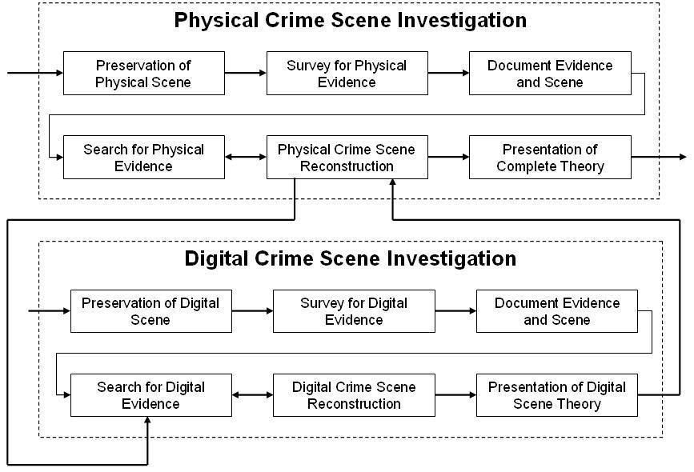
How to Investigate

Slide 55
Legal Proceedings
Cybercrime law identifies standards of acceptable behaviour for information and communication technology (ICT) users;
Establishes socio-legal sanctions for cybercrime; protects ICT users, in general, and mitigates and/or prevents harm to people, data, systems, services, and infrastructure, in particular
Protects human rights
Enables the investigation and prosecution of crimes committed online (outside of traditional real-world settings)
And facilitates cooperation between countries on cybercrime matters.
Cybercrime law provides rules of conduct and standards of behaviour for the use of the Internet, computers, and related digital technologies, and the actions of the public, government, and private organizations;
Rules of evidence and criminal procedure, and other criminal justice matters in cyberspace
And regulation to reduce risk and/or mitigate the harm done to individuals, organizations, and infrastructure should a cybercrime occur.
Accordingly, cybercrime law includes substantive, procedural and preventive law.

Slide 56
Case Study
London base fake doctor giving 24 lakhs for kidney and asked for expense to harvesting the kidney
Online extortion with 39 yr old women by 34 yr old man got 65 lakhs
Fake call from mall to verify the transaction and asked the all details
Girlfriend post the exposing photos of his boy friend on fake profile
Man created fake profile to get the affection from married woman
Boys photos were uploaded online by unknown person
Messages were send to father in law to stop the marriage to happen
Boy’s photos with past girl friend were uploaded to stop the engagement
Fake company mails
Created fake company and asked for funds to invest

Slide 57
Phishing Fraud
Applicable Sections of Law
66C and 66D of Information Technology (Amendment) Act, 2008 and Section 420 of IPC – Identity theft,
cheating by per- sonation using computer resources and cheating.
Pre-Case assessment:
After registration, the investigation has to be undertaken by an officer of the rank of Police Inspector
or above (as per ITAA 2008).
Information gathered
From complainant: Self attested copies of the printout of phishing email along with full headers printed at the police station
and soft copies of the same with date and time stamps. Details of the bank account of the victim.
From Bank:
The account statement of the complainant, which included fraudulent transaction details.
Transaction IP address of the fraudulent transaction.
Details of the beneficiaries (company to which the amount was credited for the online purchase of the electronic gadgets)
and, the delivery address of the electronic equipment.
From Website Hosting Company: Particulars of the persons responsible for hosting the phishing website.

Slide 58
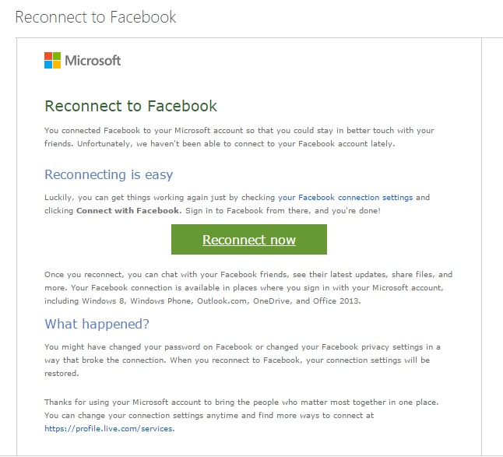

Slide 59
Fake, Obscene Account of Social Media
Applicable Sections of Law
Section 465, 469 of IPC (Forgery, Forgery for purposes of harming reputation) and Section 67 of IT Act (publication or transmission of obscene material in electronic form).
Pre-Case assessment:
Investigation to be done by an officer of the rank of Police Inspector or above (in case of ITAA 2008). Issues to be kept in mind while seeking / collection of information from complainant / accused / witnesses and service providers: The relevant date and timestamps, shall always be collected.
Information gathered
From complainant: Self attested copies of the printout of the fake profiles printed at the police station and soft copies of the offensive content with date and time stamps (self attested copies of the printout of the friendship requests received by Priya’s friends and soft copies of the offensive content with date and time stamps
Obtaining 3rd party information from service providers
Collection of Evidences from Accused / Scene of Offence
Search & Seizure of digital evidence

Slide 60
Data Theft
Applicable Sections of Law
Section 66 read with section 43 of the ITA 2000 and Section 66(B) of ITAA2008
Pre-Case assessment
Information collected from complainant
Information gathered
Obtaining 3rd party information from service providers
Search & Seizure of digital evidence

Slide 61
Kidnapping of Girl
Applicable Sections of Law
No applicable sections for “Missing Case” but, in case if there is suspicion that some known person might have kidnapped, in such cases section 363 of IPC is applicable.
Pre-Case assessment
SHO of the police station can register the case under 363 IPC and the investigation should be carried out by an officer not below the rank of Police Inspector.
Information gathered
Proof for Age-Date of Birth
Photograph of the missing person
Physical features
Languages known- to speak/write
Mobile phone number-if available
Email ID- if available

Slide 62
Investigation:
The IO sent a requisition letter to the mobile service provider under section 91 CrPC to provide the call details and tower locations details of the mobile phone used by the missing person
The call details thus obtained did not disclose any useful information because the mobile phone was switched off from the day the girl was missing and there were no entries found in the CDR.
The IO created an undercover email ID and sent a tracking mail to the missing girl’s email ID that was shared by the complainant at the time of registering the complaint.
The tracking email was sent by using free tracking email service like www. Readnotify.com or www.didtheyreadit. com
The tracking mail thus sent was opened by the user and notification was obtained in the undercover email id cre- ated by the IO
The notification page carried information like
IP address
Date and time of opening the mail
No. of time opened etc
The internet service provider was identified and a requisition letter was sent to provide the physical address de- tails
The internet service provider provided the details
The IO made a visit to the address and found that the girl was residing with Naveen.
The IO arrested Naveen under the applicable sections
The IO recorded the statement of both the accused and victim and emphasized on reason for kidnapping in the statement and the conventional investigative procedures were followed.

Slide 63
Hacking using Malware
Applicable Sections of Law
Section 66C, ITAA 2008: Punishment for identity theft, Section 66D, ITAA 2008: Punishment for cheating by personation by using computer resource
Pre-Case assessment
attested copies of email/sms received from any source other than the legitimate bank. Bank statement (if available)
Information gathered
Statement of the account of the complainant during the fraudulent activity period
Transaction IP address of the subject transaction
CAF form of the beneficiary account(in case if it is same bank)
Details of the beneficiary bank(name of bank, branch, account number etc.,)

Slide 64
Website Blocking
Applicable Sections of Law
Section 69 A, empowers the competent authorities notified under ITAA 2008 to block public access of notified websites.
Pre-Case assessment:
Power to issue directions for blocking public access to any information through computer resource
Where the Central Government or any of its officers, specially authorized by it in this behalf, is satisfied that it is necessary or expedient so to do in the interest of sovereignty and integrity of India, defense of India, security of the State, friendly relations with foreign states, or public order or for preventing incitement to the commission of any cognizable offence relating to above, it may subject to the provisions of Sub-sections (2) for reasons to be recorded in writing, by order direct any agency of the Government or intermediary to block access by the public, or cause to be blocked for access by public any information generated, transmitted, received, stored, or hosted in any computer resource.
The procedure and safeguards subject to which such blocking for access by the public may be carried out shall be such as may be prescribed.
The intermediary who fails to comply with the direction issued under Sub-section (1) shall be punished with an imprisonment for a term which may extend to seven years and also be liable to fine.

Slide 65
Information gathered
The investigating officer saved all the web pages in the subject website by using a special application by offline browsing and saved it into a CD-ROM. The IO also took the printout of the web pages.
Process for blocking Websites
Based on the above Government notification, the Police moved an application for the block- ing of the websites and submitted to the Government of India through the State Home Department.
GSR 781(E) of Gazette of India notification dated 27th Oct, 2009 prescribes the rules and process to be followed for blocking of websites. The detailed notification can be accessed at http://www.mit.gov.in/sites/upload_files/dit/files/downloads/ itact2000/Itrules301009.pdf.

Slide 66
Guidelines to prepare charge sheet
Inadequate skill in drafting the charge-sheet is one of the reasons which help the accused to get away with cybercrime committed by them. Many cases fail before the Courts of Law just because of the defective framing of charge-sheets. There are a number of incidents, where the IO has failed to file the charge sheet with all required information / documentation in cyber crimes and cases acquitted by courts of law.
Below are few guidelines for IO to include in the charge sheet.
All the relevant information shared by the complainants during registering the FIR/course of investigation should be included in the charge sheet.
Please make sure the sections mentioned in FIR are still applicable for the case OR it is advised to file a requisition to change of sections before the case including appropriate ITAA 2008 and other supportive IPC, special and local laws. ( there are number of incidents, IO filing the charge sheet under wrong sections of IT Act)
Make sure the search and seizure procedure along with Chain of custody and DEC form are included in the charge sheet.
Make sure the nature of cybercrime and the necessary information / analysis requested from FSL or forensic examiner are incorporated properly in the charge sheet.
Please provide the detailed information about the crime scene and the process IO followed to identify the systems used / affected in the crime.
Please include all the technical persons who identified, produced and analyzed the digital in the case as witness.
Please include the incidents occurred in the chronological order of time to establish the crime along with the findings.
Time plays a very critical evidence in proving cyber crimes, please mention the time stamps in a chronological order
System Time
BIOS Time
Access Time
Log times
Physical Access Time etc

Slide 67
Action Against Cyber Crime
The Protection of Children from Sexual Offences (POCSO) Act had been amended in 2019 to include the definition of child pornography under Section 2(da) and punishment provided under Section 14 and Section 15 of the Act.
Provisions to deal with cyber crime against children under Information Technology (IT) Act, 2000. Section 67B of the Act provides stringent punishment for publishing, browsing or transmitting of material depicting children in sexually explicit act, etc. in electronic form. Further, sections 354A and 354D of Indian Penal Code, 1860 provide punishment for cyber bullying and cyber stalking.
Government periodically blocks the websites containing extreme child sexual abuse material (CSAM) based on INTERPOL’s “worst of list” received through Central Bureau of Investigation (CBI), the national nodal agency for Interpol in India.
The Government is implementing a comprehensive central sector scheme, namely “Centre for Cyber Crime Prevention against Women and Children (CCPWC)” to handle all issues related to check all cyber-crime against women and children including child pornography.
National Cyber Crime Reporting Portal, www.cybercrime.gov.in has been launched by the Government to enable citizens to online report complaints pertaining to all types of cyber crimes with special focus on cyber crimes against women and children. Complaints reported on this portal are attended by the respective Law Enforcement Authorities of States. A nation-wide helpline number [155260] is also made functional to help public in filing complaints through the portal.

Slide 68
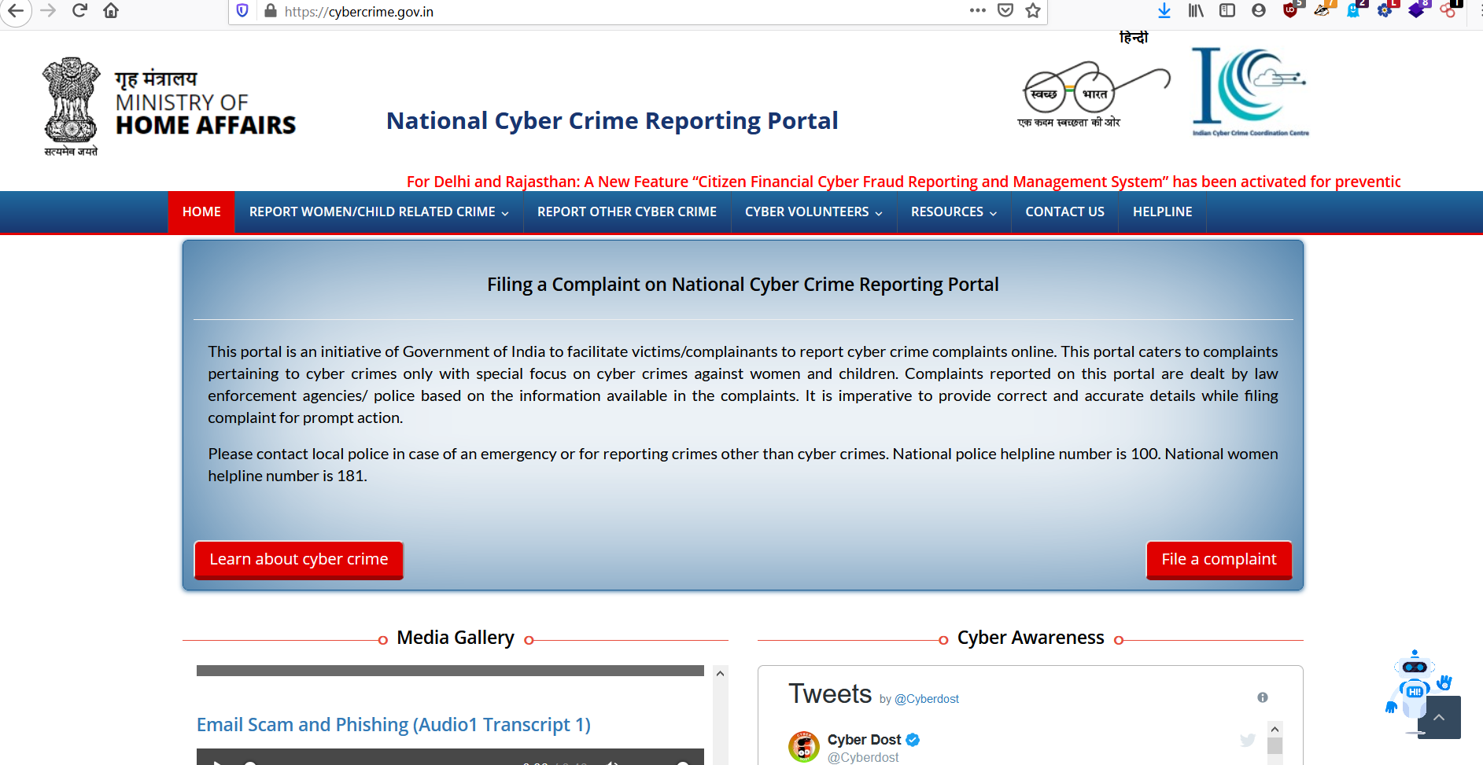

Slide 69
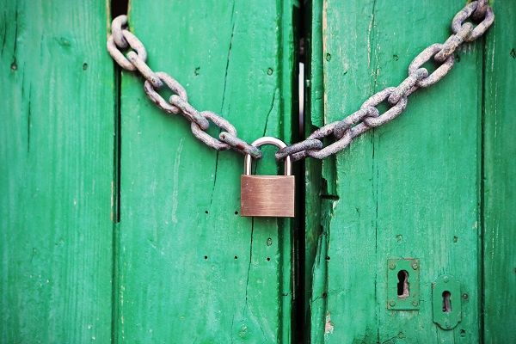


Slide 70

Any Questions

Slide 71








Contact Me
Viralparmarhacker@gmail.com
Facebook.com/viralparmarhacker
Twitter.com/viralparmarhack
Instagram.com/viralparmarhacker
Linkedin.com/in/viral-parmar
www.viralparmarhacker.com
Stay Connected
Stay Safe
+91 8980808222, +91 8866827872

Slide 72

#LogOutNow

